Slide 1
Contracts II Part 3
Mr. stasa – w-e city schools ©

Slide 2
Did you know…?
If you co-sign a loan for a friend or family member, you may have to pay that debt if they choose to default on their payments?
This true even if the person for whom you co-signed takes bankruptcy.
You will avoid paying the debt if the bankrupt person reaffirms (agrees to pay-back) their debt.

Slide 3
Exceptions to Consideration Requirements
A pledge is a promise to pay a future amount.
A gift is a transfer of ownership of an item without requiring anything in return
The party who makes the Gift receives nothing in return. Courts enforce promises (pledges) when the charity states a specific use for the money and acts in reliance on the pledge.
Notes:
When individuals make financial promises to their churches or pledges for charities and receive nothing in return for their consideration, they are not bound by the agreement. Individuals must realize that the churches and charitable organizations are counting on the pledges for their finances.

Slide 4
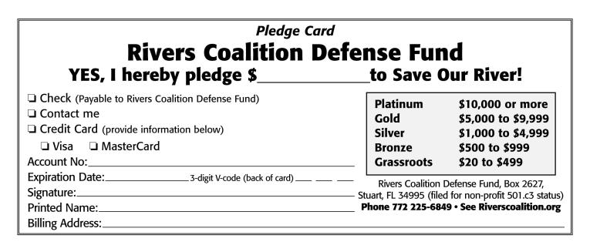
Sample pledge card

Slide 5
Can Pledges be Enforced?
Brian pledged $25,000 to the building fund of a community hospital. Relying on Brian’s pledge and other pledges, the hospital’s board of directors entered into the contract for construction to begin on the new hospital.
Can Brian be held liable in court for his pledge if he later chooses not to write the check to the hospital?

Slide 6
Statute of limitations
Statute of Limitations is a time limit for bringing a lawsuit or you lose the right to sue.
Notes:
The Statute of Limitations put time limits on bringing a lawsuit for a breach of contract. Once the time has expired, no lawsuit is relevant. Debtors may reaffirm or promise to pay their debts discharged in bankruptcy.

Slide 7
HOW MUCH TIME DO YOU HAVE TO SUE?
Ohio Statute of Limitations - 2012
Type of Actions | Year Limit to Sue
Written contract | 15
Non-written contract (oral) | 6
Breach of contract for sale of goods | 4

Slide 8
A promise?
Your neighbor promises to pay you $30 to mow their yard and they said you have a week to decide. Before the week is up, they end up giving the job to their nephew instead. Do you have the legal right to the job instead of the nephew?

Slide 9
Promises Covered by the UCC
Firm Offers – Firm offer is a written offer that is open for the time stated in the offer or up to three months max.
Eric is planning to replace the fence in his yard and asked several contractors to quote him on replacement pricing. Author’s Fencing promises to replace Eric’s fence for $2,000, but that the price is only good if Eric replies by April 15. Had Author’s Fencing not stated the date the offer was valid for, could Eric hire this company after April 15 and still expect to only pay $2,000?
Notes:
Contracts must involve good faith. Both parties must be certain about the agreement. Firm offers are open for a stated period of time or three months.

