Slide 1
Contracts II Part 2 Value
Mr. Stasa – W-E City Schools ©

Slide 2
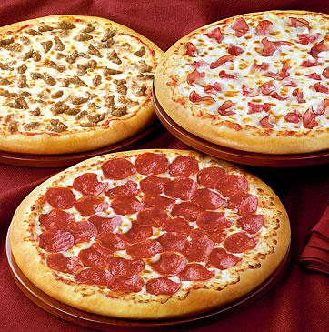
What do you think?
Ms. Miller a high school math teacher says to her students, “all of you have worked hard, and if you continue to perform at this high level, I’ll pay for a pizza party for the class at the end of the semester- if I feel it is warranted.” The students continue to perform well but no pizza party was ever given. Can the students enforce this promise?

Slide 3
Illusory Promise
Illusory promise is the clause which allows you to be relieved of the obligation
Promisor says, “I promise to paint your house if I have the time.” This does not bind you to a legal obligation since you may never have the time to paint the promisee’s house.
Usually the word “if” is included in the contract

Slide 4
Termination Clause
Termination Clause is the power to withdraw from a contract if circumstances change
Ie. If a renter stops making rent payments, the landlord has the right to cancel the lease (contract).

Slide 5
Existing Duty
Existing duty is when a person is already legally obligated to perform a specific duty per a contract or a law.
Ie, In your sixteen birthday your aunt promises to pay you $10,000 if you promise not to drink for two years. You agree. Is this an enforceable contract?
There is no consideration since you are already bound by law NOT to drink. Therefore, this contract is invalid and cannot be enforced.

Slide 6
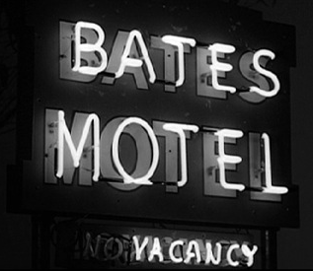
Another example of Existing Duty
Lemsky hired Volk to manage a motel for $25,000 a year as well as live in an apartment for free. Volk accepts and begins working. Six months later Fleming offered Volk $30,000 to work at an even larger motel. Lemsky heard about Volks recent offer and said, “You’re great, honest, and a hard worker. I’ll meet any new offer you get.” Volk stays with Lemsky. Does Lemsky have to pay Volk more money?
Because Volk is not performing additional work than originally agreed to, Lemsky does not owe Volk more money.

Slide 7
Settlements of Debt
Liquidated debt (very common) is where both parties agree that debt exists and on the amount due.
Ie. Terry purchases a house through Chase Bank for $150,000. Terry will owe payments of $950 a month for the next 30 years. If Terry doesn’t pay at least $950 a month, he will be charged penalty fees. (no change in contract)
Ie. Shawn took out a loan of $500 to purchase a car. Next month he only was able to pay $475 and wrote a note that the bank will have to accept $475 as full payment on the loan since he ran out of cash. The bank cashed his check of $475, but is still owed the remaining $25 and can sue Shawn if left unpaid.

Slide 8
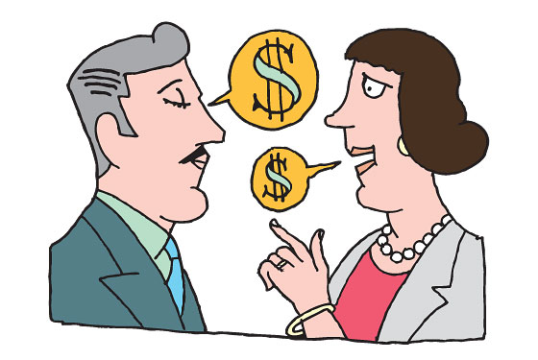
Accord and Satisfaction
Accord and satisfaction is a payment offered in full settlement by the debtor (the person who owes money) and accepted by a creditor (the person who is owed money) which fully settles the contract.
Mary was charged $2,000 on her credit card bill. She believes her bill should be $1,500 but the company fully believes the amount is $2,000. Both Mary and the credit card company compromise and agree that payment of $1,750 will satisfy as full payment of Mary’s debt.

Slide 9
Release of Contract
A contract release is when both parties involved in a situation agree there are no claims against each other upon payment of money.
Ie. If you were involved in a car accident and your car was damaged, you may choose to accept money from the driver who hit you in full payment of damages to your car.
This is not recommended, because you may not be aware of the full extent of your car’s damages as well as any physical injuries you have a incurred. If you agree to a contract release, you no longer have legal grounds to sue or ask for more money if further damages are discovered.

Slide 10
Composition of Creditors
Composition of creditors is when creditors (the people whom money is owed to) agree to accept less than what they are legally entitled to as full payment on a debt in exchange for the debtor not to file for bankruptcy.

Slide 11
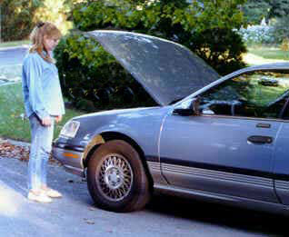
Question of Ethics
You see a lady with her two kids stranded in a local parking lot. You offer to jump-start her car battery and her car starts. She is very grateful for you help and offers to send you $20 in the mail for your help. Months have past and you’ve never received the $20. Is the lady legally responsible for paying you the $20?
No. Because she promised to pay you after you performed the act, there was no mutual consideration. Even if $20 was a gift, gifts have no legal value.

