Slide 1
Contracts Pt 6
Mr. Stasa – W-E City Schools ©
http://www.youtube.com/watch?v=9uA5oA2-xGw

Slide 2
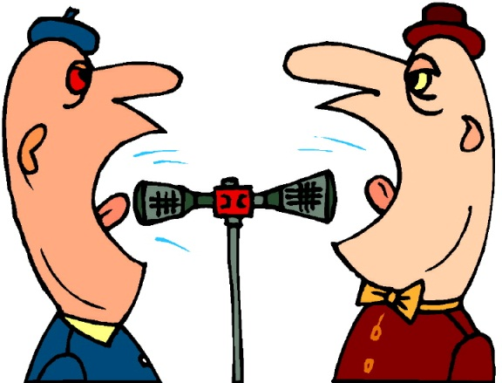
Hot Debate
For a graduation present, Maureen's aunt promised to give her two round-trip tickets for a cruise of the Mexican Riviera. The day of graduation, her aunt gave her a hug instead and said, “The stock market is down. Sorry.”
Do you think Maureen should be entitled to the tickets?
Do you think the aunt doesn’t owe the tickets?

Slide 3
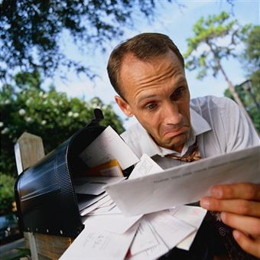
What’s your verdict?
Your neighbors are going on a 10 day skiing vacation. They offer to pay you $50 upon their return if you pick up their mail each day. You accept by picking up their mail.
Is there consideration for both parties?
Is this an enforceable contract?

Slide 4
Is the promise of a gift enforceable?
A gift is the transfer of ownership of an item of value without receiving anything in return.
The promise of a gift is not enforceable

Slide 5
When does the offering of a gift transfer ownership to the receiver?
As soon as the gift is given (or sent) to the receiver the gift officially transfer ownership.
As soon as Alice drops off her packages at the UPS store to be shipped to her niece, the gifts transfer ownership as soon as the shipping label (or postmark) is placed on the package.

Slide 6
Can someone promise to not do something?
Forbearance is the promise to not do something.
Jack promises his neighbor to not play his music loudly when having his graduation party.

Slide 7
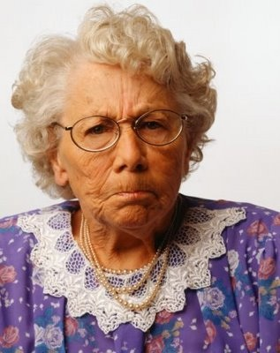
Must both parties exchange consideration for a promise to be valid?
Consideration must be mutual.
Each party must give consideration, and each must receive consideration.
If one party does not give consideration, than the other party has no obligation to fulfill the promise.

Slide 8
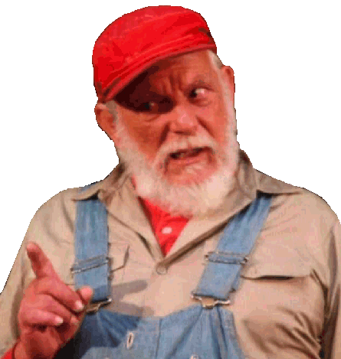
Is there legal value when you promise to not do something?
There is legal value in forbearance
There is also legal value in detriment
A detriment is the promise to not do something that you have the right to do.
Your uncle promises you on your 18th birthday that if you refrain from smoking until you’re 21, he’ll give you $25,000.
A change in your legal right is consideration.

Slide 9
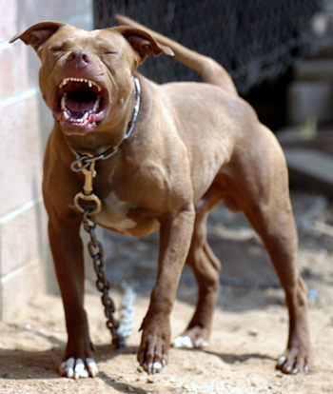
Is there consideration?
Legal value can also have value when exchanging two detriments.
If you promise your neighbor that you’ll forbear buying a pit-bull if your neighbor forbears building a fence.
Both parties have changed their legal right to do what they’re entitled to do. Therefor, there’s mutual consideration.

Slide 10
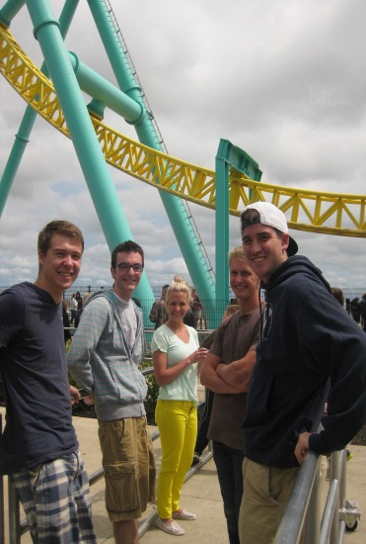
Does consideration on both parties have to be equal value?
Consideration does not need to be of equal value
Ray was sitting in the hot sun in the line at Cedar Point for 4 hours. He offered to pay the person next to him $5 for a bottled water to cool off. The guy only bought the water for $1,but he agreed to give it to Ray since he was willing to pay for it.

Slide 11
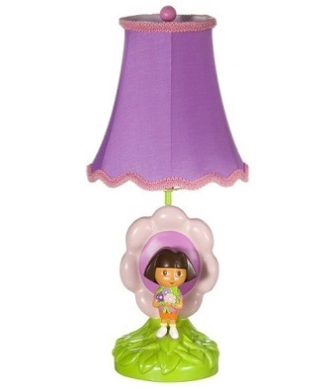
However…
If consideration received by one of the parties is extremely inadequate that it shocks the conscience of a court, the contract will be declared unconstitutional.
Steve was cleaning out his attic when his friend Chris saw lamp that he knew was worth $200,000. Chris offered Steve $10 for the lamp and Steve agreed, not thinking the lamp was worth much. Once Steve discovered the real value of the lamp, he sued Chris for the full value of the lamp and won.

Slide 12
Assignment
Page 131
#s 8-10
Create an example of an agreement involving forbearance, making sure both parties have mutual consideration.
Create an example of an agreement where the consideration on both parties is not of the same value

