Slide 1
Intro to Laws (Part 2)
Mr. Stasa – W-E City Schools ©

Slide 2
Review…
Laws are enforceable rules of conduct in a society.
Criminal law involves punishment by jail time , fines, or death (police involvement).
Civil law involves punishment by monetary compensation (suing – no police involvement).

Slide 3
Review…
A misdemeanor is a less serious crime.
Typical punishments are:
Fines
Jail time (less than a year)
Example:
Driving without a license
A felony is a major crime.
Typical punishments are:
Fines
Prison (more than a year)
Death
Examples:
Murder
Robbery

Slide 4
What do you think about this…?

Slide 5
The Plaintiff, Mr. Allen, is suing Defendant, Fast Food Chain, for damages for injuries suffered on the restaurant premises.
Plaintiff: Mr. Jones
One night, I was at a friend’s home near Fast Food Chain. I got hungry and decided to go to Burger World to get a hamburger because Fast Food Chain was closed. But, in order to get to Burger World, I had to cut through the property of Fast Food Chain. When I got to Burger World, I realized that I had no money and decided on my way back to see if there was anything left in the dumpster behind Fast Food Chain. As I climbed over the wall surrounding the dumpster, it collapsed and I fell, breaking my leg. I know that Fast Food Chain was aware of the danger the wall posed and they have a duty to keep the premises safe, so now they owe me money for the injury I suffered.
Defendant: Fast Food Chain
We admit that there was knowledge of the damaged wall surrounding the dumpster. But, what was Mr. Allen doing in the dumpster after hours, in the middle of the night anyway? We cannot expect or foresee a person climbing into the dumpster, so we do not owe a duty to a person who injures themselves while doing so.

Slide 6
VERDICT…
Case #1: DECISION FOR THE DEFENDANT
The Missouri Court of Appeals for the Eastern District held that because Mr. Allen had no implied permission to climb on the wall leading to the dumpster, Fast Food Chain had no duty to protect Mr. Allen from the wall.
Cochran v. Burger King, Co., 937 S.W.2d 358

Slide 7
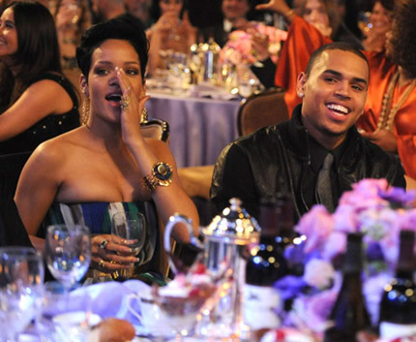
How to Classify a Crime
Two elements must exist for an action to be considered a crime:
The action must violate a law
A state of mind (intent) to commit the crime
Must there be a motive for the action to be considered a crime?
NO!
5 years of probation!
1,400 hours community service!

Slide 8
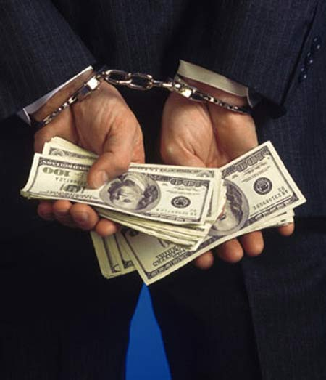
Types of Crimes
Types crimes:
Against people
Against property
Against businesses (white collar)
Let’s break these down with more slides!

Slide 9
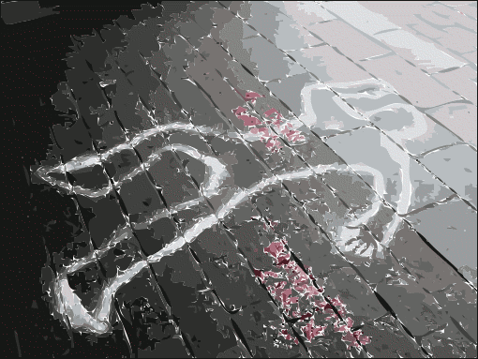
Today: Crimes Against People

Slide 10
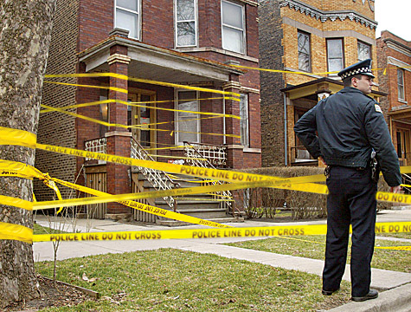
Murder!
Murder is the killing of another person intentionally.
1st degree murder is pre-planned intentional murder, and can receive the death penalty
2nd degree murder is when a person kills another intentionally, but did not have a plan to do so.

Slide 11
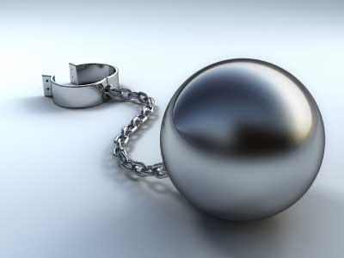
Manslaughter!
Manslaughter
Voluntary
Involuntary
Voluntary manslaughter occurs when a person intentionally kills another during a heat of passion without a prior plan.
Physical fight
Involuntary manslaughter is when someone unintentionally kills another while committing another unlawful crime.
Drunk driving and crashing into another car

Slide 12
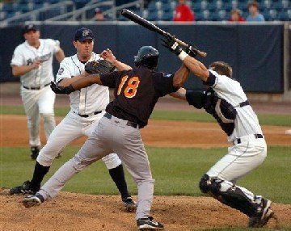
Assault
Assault is a threatened or attempted physical attack that would appear to cause serious harm if not stopped
Threatened: Waving a baseball bat in front of someone threatening harm
Attempted: Throwing the baseball bat to cause harm but the victim was able to dodge the bat.

Slide 13
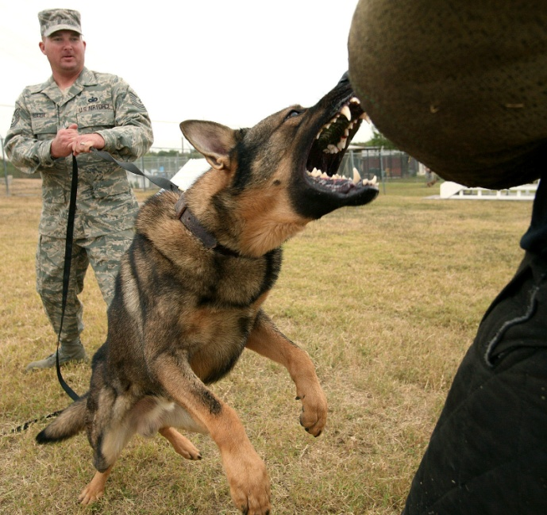
Battery
Battery is the forceful act of one’s hand or weapon against a person’s will.
Punching in the face
Ordering your dog to attack a person

Slide 14
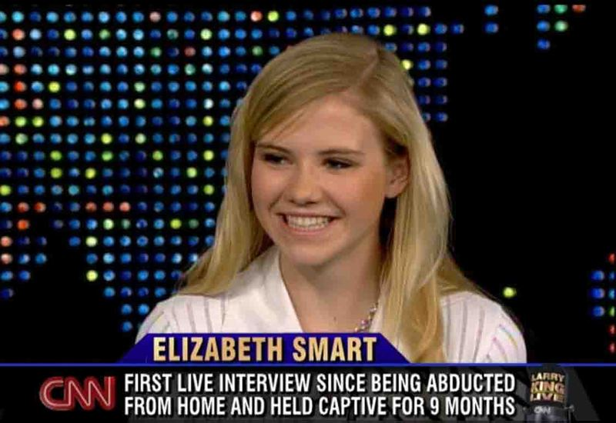
Kidnapping
Kidnapping is the removal of a person against their will.

Slide 15
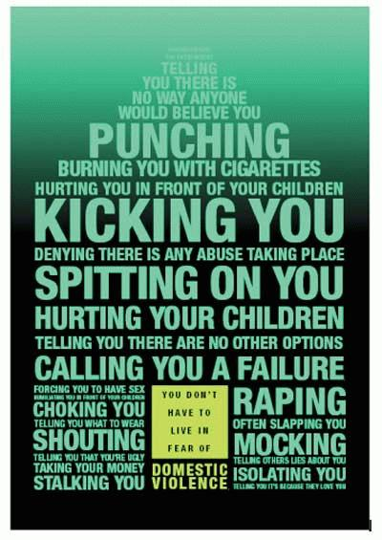
Domestic Violence
Domestic violence is an act of physical or mental harm in a household .

Slide 16
GUESS THESE CRIMES!

Slide 17
What crime is this?
Jane was holding up the National Bank with a gun. On her way out the door an employee tried to stop Jane, but Jane ended up shooting and killing the employee with the gun.
2nd degree murder

Slide 18
What crime is this?
Marvus threatens to beat up George by posting a message on his facebook wall.
Assault

Slide 19
What crime is this?
Joe was driving on the highway during icy conditions. Joe’s car spins out of control and kills the driver of another car.
Involuntary manslaughter

Slide 20
What crime is this?
David was waiting outside of Chris’s job in the parking lot with a gun to kill him. As soon as Chris walked out to the parking lot David shot and killed Chris.
1st degree murder

Slide 21
What crime is this?
Vanessa severely beats up Krystal after work.
Battery

Slide 22
What crime is this?
David tripped over Kyle’s foot while carrying a tray of food. David was so upset that he angry starts beating on Kyle and ends up killing Kyle with a blunt force to the head.
Voluntary manslaughter

