Slide 1
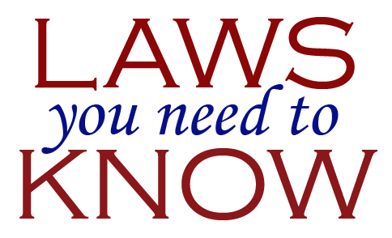
Intro to Laws Part 3
Mr. Stasa – Willoughby-Eastlake City Schools

Slide 2
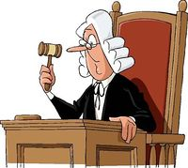
Jurisdiction
Jurisdiction The authority of a court to hear and decide a case.
Some courts have "general" jurisdiction, which means they may hear all types of cases; other courts have "limited" jurisdiction, which means they may only hear certain types of cases
Do you feel it would be necessary for the Supreme Court of the United States (SCOTUS) to hear a case involving you suing your friend for $500 over allegedly damaging your cell phone?
If you were caught speeding on Lakeshore Blvd. in Eastlake, which court would hear your case if you wanted to dispute it?

Slide 3
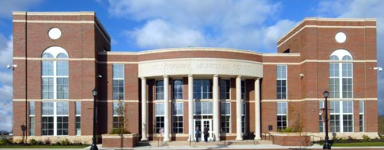
Willoughby Municipal Court
Willoughby Municipal Court has jurisdiction over 10 communities and 14 agencies, which include the Cities of Eastlake, Kirtland, Wickliffe, Willoughby, Willoughby Hills and Willowick, and the Villages of Kirtland Hills, Lakeline, Timberlake and Waite Hill. The Court also has jurisdiction over the Lakeland Community College, the Cuyahoga and Lake County Metroparks located within its jurisdiction, the Eastlake Port Authority, and 10 other State and County Agencies.
Willoughby Municipal Court tries all misdemeanors, ordinance violations and traffic cases occurring within its jurisdiction, civil cases (where $15,000 or less is in controversy) and small claim complaints (where $3,000 or less is in controversy) and landlord cases.
http://www.willoughbycourt.com/

Slide 4
Lake County Juvenile Court
The Lake County Juvenile Court has exclusive jurisdiction concerning any person under eighteen years old who is alleged to be a juvenile traffic offender, delinquent, unruly, abused, neglected, or dependent child.
The Juvenile Court also has jurisdiction in adult cases involving paternity, child abuse, non-support, contributing to the delinquency of minors, and failure to send children to school
Judge
Karen Lawson

Slide 5
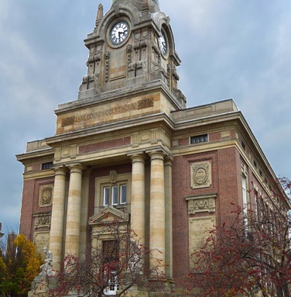
Lake County Common Pleas Court
The Lake County Common Pleas Court in Painesville, General Division, has jurisdiction to hear criminal felony cases where the penalty imposed could be community control (probation) up to life imprisonment, or in some cases, death.
The court hears civil cases with no limit on the amount that can be awarded. In addition, it hears appeals from the decisions of state and local administrative agencies.
About 3,300 new cases are filed each year, including 1000 felony cases and 800 foreclosure cases.

Slide 6
Ohio Court Structure
http://www.sconet.state.oh.us/SCO/jurisdiction/structure.pdf

Slide 7
Federal Courts
The federal courts are courts of limited jurisdiction because they may only decide certain types of cases.
Basically, federal courts hear only two types of cases; those that raise a “federal question,” and those involving “diversity of citizenship.”
Federal Question Jurisdiction: These cases involve the U.S. Government, the U.S. Constitution or other federal laws.
Examples include: A crime that is a violation of federal law, such as bank robbery, drug cases, guns, or kidnapping. • Cases involving interstate commerce or interstate criminal activity. • Civil cases based on federal laws, such as laws prohibiting employment discrimination, or laws regulating securities trading or competition (anti-trust)

Slide 8
Federal Question Jurisdiction
Federal Question Jurisdiction, continued….
• A controversy arising out of the U.S. Constitution or other federal laws, such as a violation of a protection guaranteed by the Bill of Rights. • A case in which the United States is a party, such as Social Security claims or federal tax violations. • A controversy between two states. • A case involving foreign governments such as international trade or foreign treaties. • All bankruptcy, patent, copyright, Native American, and maritime cases.

Slide 9
Federal Diversity of Citizenship
Diversity of Citizenship Jurisdiction: These cases involve disputes between two parties not from the same state or country.
Examples include: • Between citizens of two different states. • Between a U.S. citizen and a citizen of another country. • NOTE: The case must involve a claim for at least $75,000 in damages – if not, then it must be filed in state court instead.

Slide 10
State Courts
The state courts are courts of “general jurisdiction.” They hear all the cases not heard by federal courts. About 90% of all the cases heard in the American court system happen at the state level.
Examples include: • A crime that is a violation of state law. Most criminal activity falls in this category, such as robbery, assault, murder, and many drug-related crimes. • A controversy arising out of the state constitution or other state laws. • A case in which the state is a party, such as state tax violations. • Most real estate cases, malpractice, personal injury cases, and contract disputes. • All family, divorce, custody, inheritance, and probate cases. • Most traffic and juvenile cases.

