Slide 1
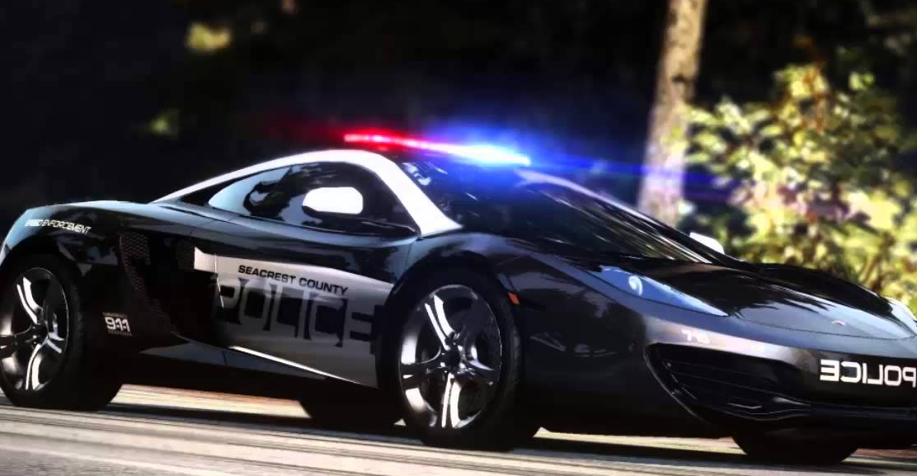
Law Procedures Part 2
Mr. Stasa – WE City Schools ©

Slide 2
Vocabulary
Jurisdiction: gives the power to decide a case
Precedent is when courts use prior cases as a guide for deciding similar cases. Precedent provides consistency
Stare decisis means to “let the
decision stand.” Lower courts must
follow existing law in deciding
any similar case.
Where is precedent used at North?
https://www.youtube.com/watch?v=Xzq-x-hytJY

Slide 3
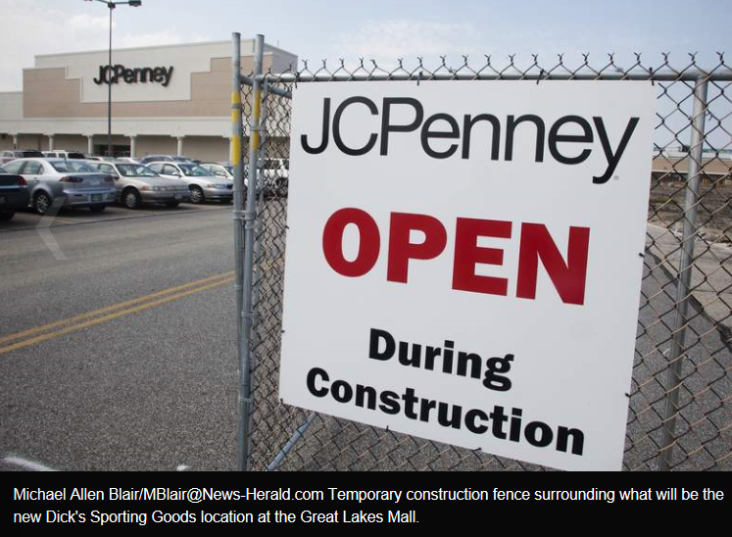
Injunction
An injunction is a court order (temporary or permanent) requiring a person or corporation to stop doing something
An example of an injunction is a restraining order
http://www.news-herald.com/general-news/20130830/jc-penney-asks-judge-to-halt-construction-of-new-dicks-sporting-goods-store-in-mentor

Slide 4
What’s Your Verdict? The labor strike is in its fifth bitter week. The strikers are tense and angry. The workers who remain on the job are both angry and fearful about the situation. For several days nearly a thousand picketers gather at the company’s main gate. They are chanting slogans and jeering those who enter the plant. The crowd begins to throw rocks at the workers who cross the picket line. Then a company truck is set on fire and destroyed.
What powers do the courts have that would be useful in this situation? -injunction or awards of money for loss of truck Injunction
An order that restrains a person from beginning or continuing an action threatening or invading the legal right of another. • An order to cease & desist Create a list of MODERN DAY references in which an injunction is important

Slide 5
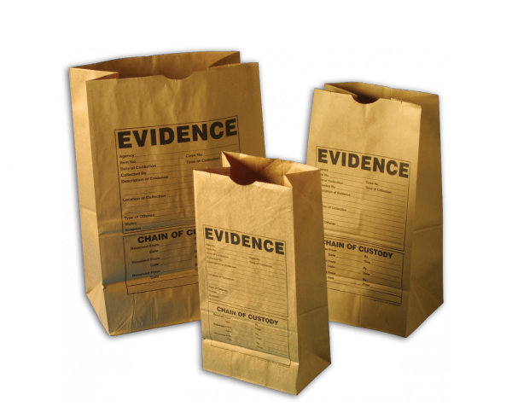
In the court room
Evidence includes anything that the judge allows to be presented to the jury to help prove or disprove facts.
Evidence may consist of:
Written documents
Records
Charts
Weapons
Photographs
Other objects
http://www.youtube.com/watch?v=gqLuJXixU9c

Slide 6
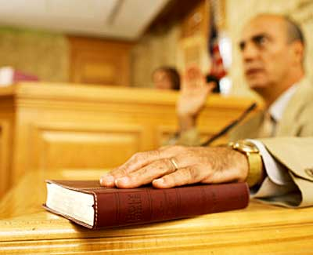
Forms of evidence
Testimony consists of statements made by witnesses that are sworn under oath.
A witness is someone who has first-hand knowledge of facts (never hearsay)
Sometimes an expert witness can give an opinion on scientific facts who was not at the scene of the crime.
http://www.youtube.com/watch?v=UMA3dhtvEV0

