Slide 1
LESSON 1-2
How Business Activities Change the Accounting Equation

Slide 2
Review…
Assets are anything of value (tangible) that are owned.
An amount owed by a business is a liability
The owner’s financial rights to the assets (money) of the business is owner’s equity.
Accounting equation:
The left side must ALWAYS equal the right side.
LEFT SIDE
RIGHT SIDE

Slide 3
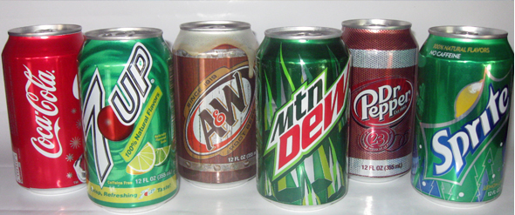
Terminology
A transaction is a business activity that changes assets, liabilities, or owner’s equity.
Every transaction affects the accounting equation.
For example, when you buy a bottle of pop, you must decrease you assets (cash) and then increase your supply of pop (asset).
An account is a record summarizing all information pertaining to a single item in the accounting equation
An account title is the name given to an account.
For example, your asset account title, cash, decreased when you purchased your bottle of pop, while your other asset account title, beverages, increased.

Slide 4
Accounting lingo
The words “received cash” represents an increase in cash
The words “paid cash” represents a decrease in cash

Slide 5
Accounts and Account Titles
ASSETS:
Cash: The account used to summarize the amount of money a business has available.
Supplies (paper, ink, folders, etc.)
Prepaid Insurance: Prepaid insurance coverage (premiums)
LIABILITIES:
Accounts/Payable: Items purchased now but paid for at a later date – referred to as on account.
OWNER’S EQUITY
Capital: Summarizes all Owner’s Equity transactions

Slide 6
Steps to Reading a Transaction
Read the transaction
Identify which accounts are affected and how they are affected.
Classify accounts as either an asset, liability, or owner’s equity.

Slide 7
RECEIVING CASH
Read the transaction
Identify the accounts affected
Classify accounts as either A, L, or OE
page 10
Transaction 1 August 1. Received cash from owner as an investment, $5,000.00.

Slide 8
PAYING CASH
Read the transaction
Identify the accounts affected
Classify accounts as either A, L, or OE
page 11
Transaction 2 August 3. Paid cash for supplies, $275.00.
Transaction 3 August 4. Paid cash for insurance, $1,200.00.
Sometimes a transactions will only affect one side of the equation, but both sides must still be equal.

Slide 9
TRANSACTIONS ON ACCOUNT
Read the transaction
Identify the accounts affected
Classify accounts as either A, L, or OE
page 12
Transaction 4 August 7. Bought supplies on account from Supply Depot, $500.00.
Transaction 5 August 11. Paid cash on account to Supply Depot, $300.00.

Slide 10
1-2 Work Together (WT)

