Slide 1
LESSON 3-1
Journals, Source Documents,
and Recording Entries
in a Journal

Slide 2
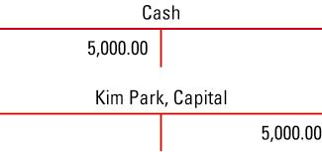
What’s a Journal?
So far we’ve been able to break down parts of transactions into debits and credits using a T-account
Now we will be using a specialized form that’s used to record debits and credits in chronological order

Slide 3
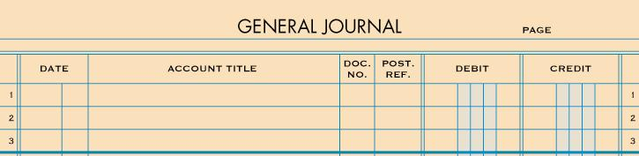
A GENERAL JOURNAL
page 57
A journal is a form that’s used to record transactions in chronological order on a daily basis.

Slide 4
What is a Source Document?
Every transaction that is journalized MUST have proof that it exists to verify for accuracy.
A source document is a form which information is obtained from to journalize a transaction
A transaction cannot be journalized without a source document to prove it.

Slide 5
Types of Source Documents and Abbreviations
CHECKS | C
SALES INVOICES | S
RECEIPTS | R
CALCULATOR TAPES | T
MEMORANDUMS | M

Slide 6
CHECKS - C
page 58
A check is used for making cash payments and orders a bank to pay (debit) cash from a bank account.
Each check is prenumbered to account for all checks.

Slide 7
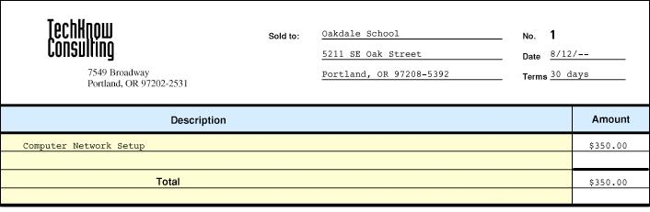
SALES INVOICES - S
page 58
A sales invoice is used to record a sale on account.
Each sales invoice is prenumbered to account for all invoices.

Slide 8
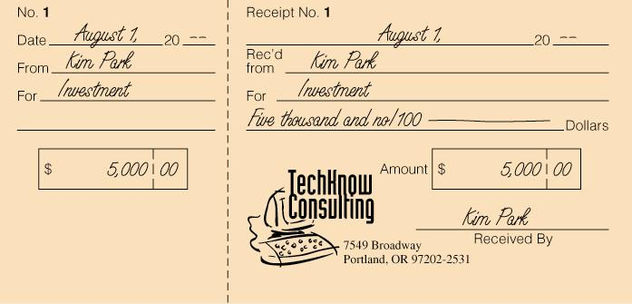
Receipt - R
A receipt is written acknowledgment for cash received regarding transactions other than sales.

Slide 9
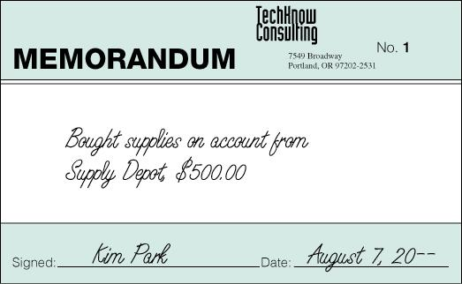
Memo - M
A memo is a form in which a brief message is written on describing a transaction when no other source document can be used.

Slide 10
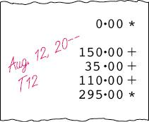
Calculator Tape - T
A calculator tape is used to total the amount of cash received from sales for each day.
Each tape is numbered with each day’s date. T12 in the example above refers to August 12.

Slide 11
Four Steps to Journalizing a Transaction
page 60
1. Write the date in the Date column (list chronologically).
2. Write the title of the account debited. Write the debit amount.
3. Write the title of the account credited. Write the credit amount.
4. Write the source document number in the Doc. No. column.

Slide 12
RECEIVED CASH FROM OWNER AS AN INVESTMENT
page 60
August 1. Received cash from owner as an investment, $5,000.00. Receipt No. 1.
1. Write the date in the Date column.
2. Write the title of the account debited. Write the debit amount.
3. Write the title of the account credited. Write the credit amount.
4. Write the source document number in the Doc. No. column.

Slide 13
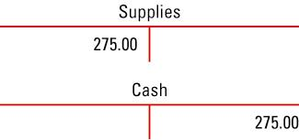
PAID CASH FOR SUPPLIES
page 61
August 3. Paid cash for supplies, $275.00. Check No. 1.
1. Write the date in the Date column.
2. Write the title of the account debited. Write the debit amount.
3. Write the title of the account credited. Write the credit amount.
4. Write the source document number in the Doc. No. column.

Slide 14
3-1 Work Together

