Slide 1
LESSON 8-3
Preparing a Post-Closing Trial Balance

Slide 2
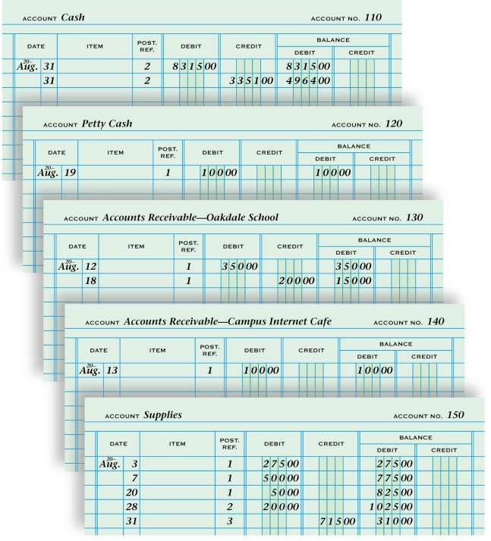
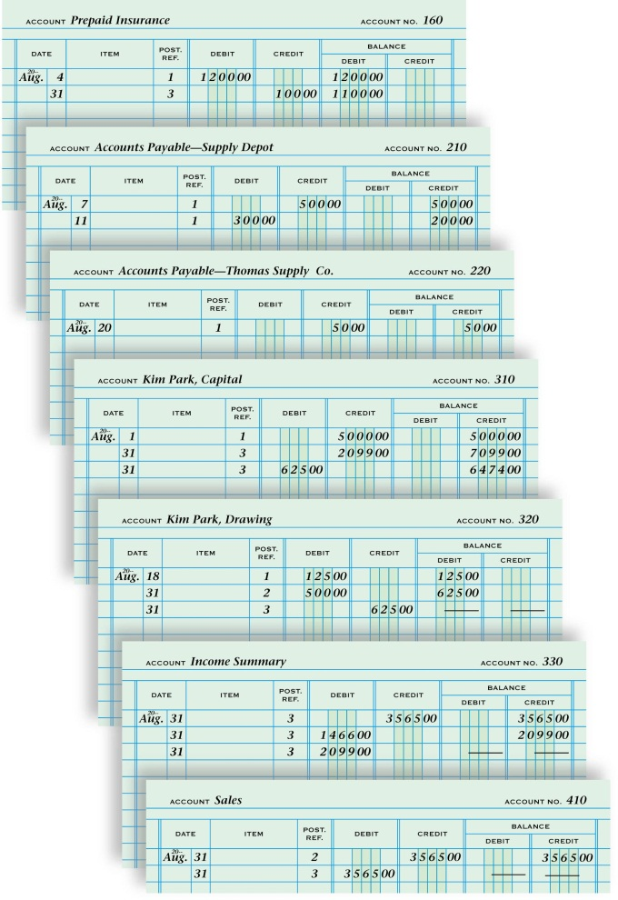
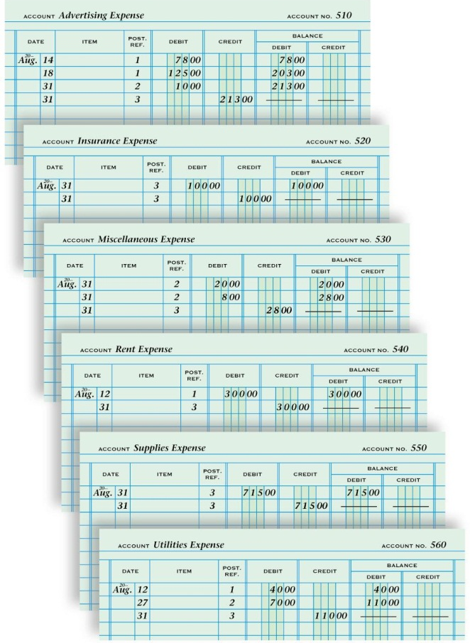
GENERAL LEDGER ACCOUNTS AFTER ADJUSTING AND CLOSING ENTRIES ARE POSTED

Slide 3
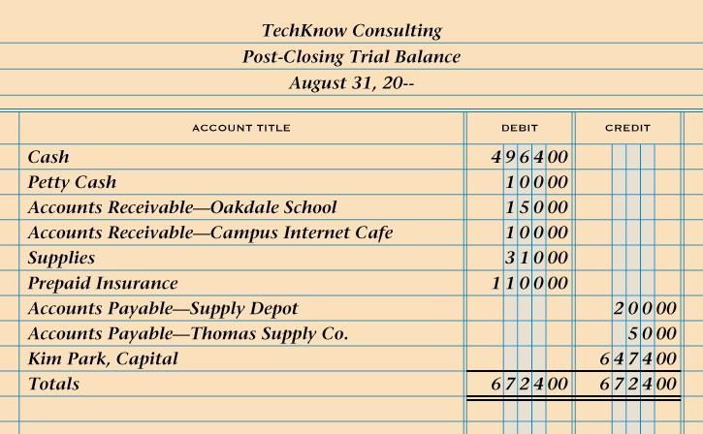
POST-CLOSING TRIAL BALANCE
page 216
1. Heading
2. Account titles
3. Account balances
4. Single rule
5. Compare totals
6. Totals
7. Record totals
8. Double rule

Slide 4
