Slide 1
2-2: Analyzing How Transactions Affect Accounts
Mr. Stasa – WE City Schools
http://northbiz.weebly.com
http://www.twitter.com/@north_biz

Slide 2
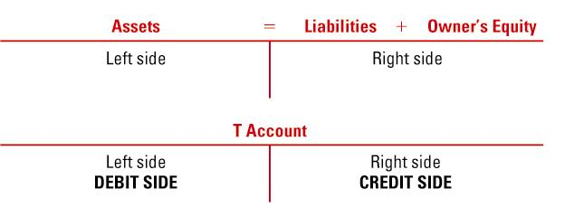
Review of 2-1…
Each T-account has a debit (left side) and a credit (right side).

Slide 3
Review of 2-1…
page 30
Assets include:
Cash
Supplies
A/R
Prepaid Insurance
-
+

Slide 4
Review of 2-1…
page 30
Liabilities include:
A/P
-
+

Slide 5
Review of 2-1…
page 30
Owner’s Equity
includes:
Capital
Revenue
Investments
Expenses
Withdrawals
-
+

Slide 6
Keep in mind…
There are always two actions in every transaction
You will only have one debit and one credit for each transaction
Always list your debit amount first, then credit amount second.

Slide 7
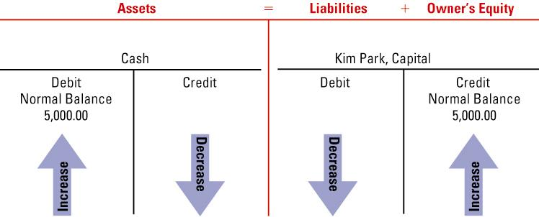
RECEIVED CASH FROM OWNER AS AN INVESTMENT
page 32
August 1. Received cash from owner as an investment, $5,000.00.
1. Which accounts are affected?
2. How is each account classified?
3. How is each classification changed?
4. How is each amount entered in the accounts?

Slide 8
PAID CASH FOR SUPPLIES
page 33
August 3. Paid cash for supplies, $275.00.
1. Which accounts are affected?
2. How is each account classified?
3. How is each classification changed?
4. How is each amount entered in the accounts?

Slide 9
PAID CASH FOR INSURANCE
page 34
August 4. Paid cash for insurance, $1,200.00.
1. Which accounts are affected?
2. How is each account classified?
3. How is each classification changed?
4. How is each amount entered in the accounts?

Slide 10
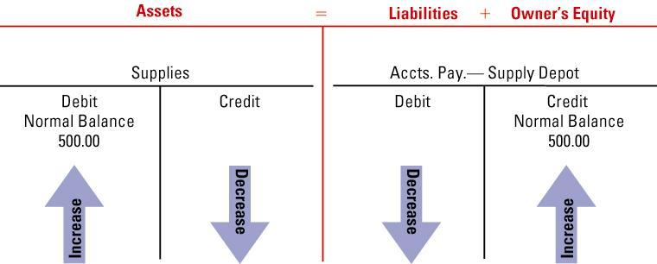
BOUGHT SUPPLIES ON ACCOUNT
page 35
August 7. Bought supplies on account from Supply Depot, $500.00.
1. Which accounts are affected?
2. How is each account classified?
3. How is each classification changed?
4. How is each amount entered in the accounts?

Slide 12
