Slide 1
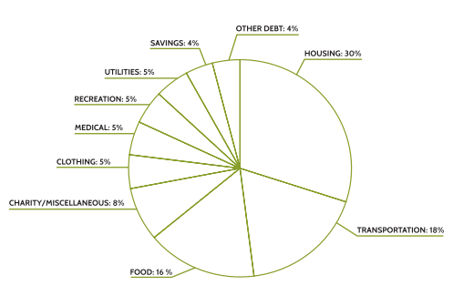
Spending Categories
Spending Categories with Limits
Housing | 30%
Other (student loans, etc.) | 12%
Utilities | 5%
Recreational | 5%
Medical | 6%
Clothing | 8%
Food | 16%
Transportation | 18%

